Slide 1


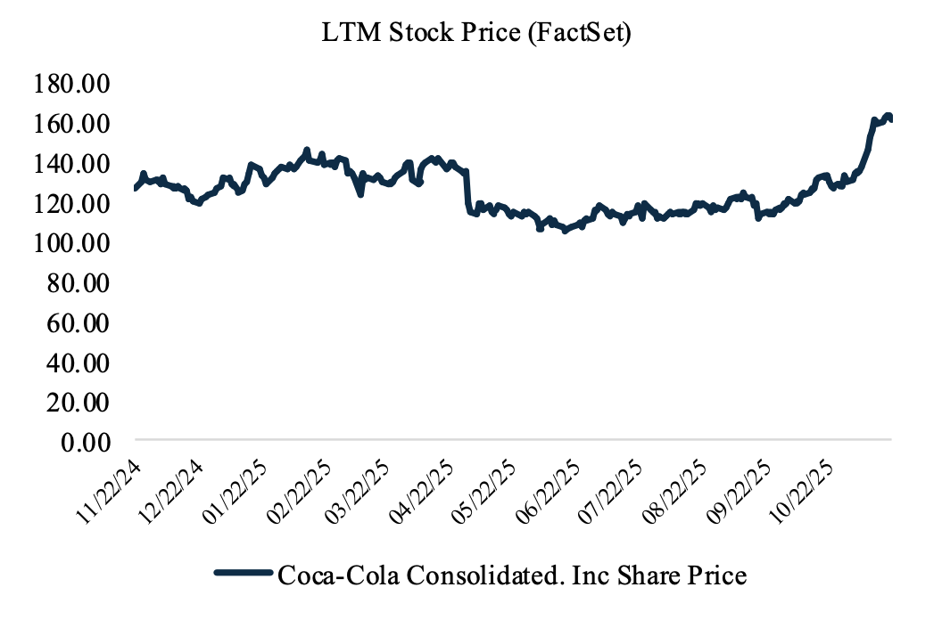
Research Report | 11.30.2025
Coca-Cola Consolidated, Inc
Research Summary
Researched by Name
www.faccting.com
Company Overview
Introduce the company.
Tips: Include information like the industry, origin, and products of the company.
Hold / Buy / Sell
Ticker: COKE
Target Share Price:
Current Share Price:
Data Date:
52 Week Range: $0.00 ~ $0.00
Current Stock Price: $0.0
P/E Ratio (LTM): 0.0
Beta Estimate: 0.0
Dividend Yield: 0.0%
2024 DPS: $0
2024 P/S: $0.00
EV/Sales: $0.00
WACC: $0.00
P/BV: $0.00
Equity Value: $0.00
Enterprise Value: $0.00
Industry: Beverage Production
Valuation
Bring the result from DCF, P/E Model or other valuation models and explain the reason why you chose ‘Hold’, ‘Buy’, or ‘Sell’.
You can also make a chart from Excel, etc.
Here’s an example:
Retrieved from FactSet

Slide 2
Contents
Research Report | 11.30.2025
1. Company Analysis 3
2. Discounted Cash Flow 7
3. Comparable Analysis 11
4. Dividend Discount Analysis 14
5. Conclusion

Slide 3
Company
Analysis
Research Report | 11.30.2025

Slide 4
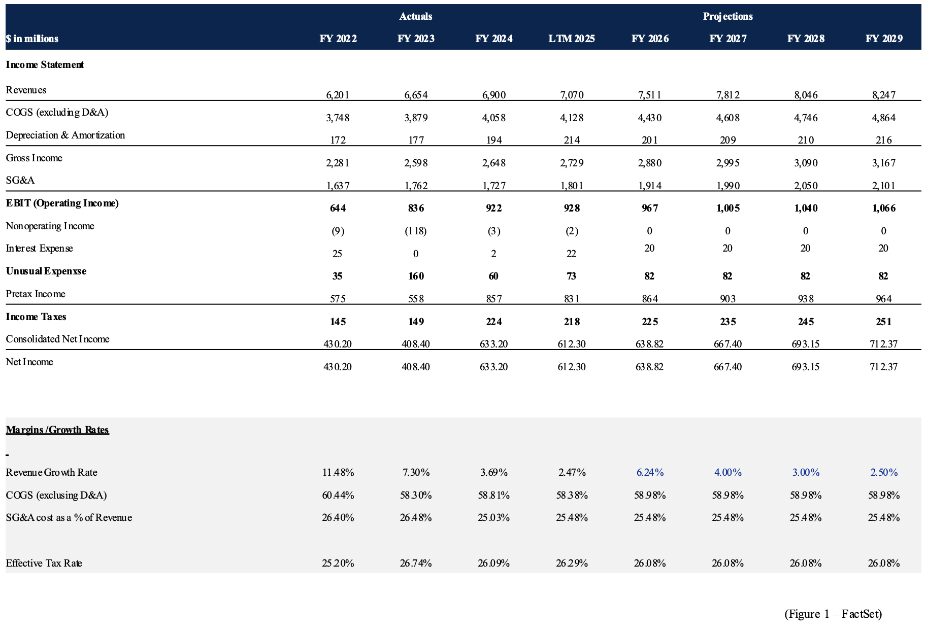
Company Analysis
Research Report | 11.30.2025
Financial Statements
Revenue Projections
Explain the Revenue changes from the recent years.
Then, explain the reason why it has changed. You can normally find this on 10-K of the company.
If the revenue have been decreasing, you can explain how the company could overcome this issue.
You can also add some data like the image below.

Slide 5
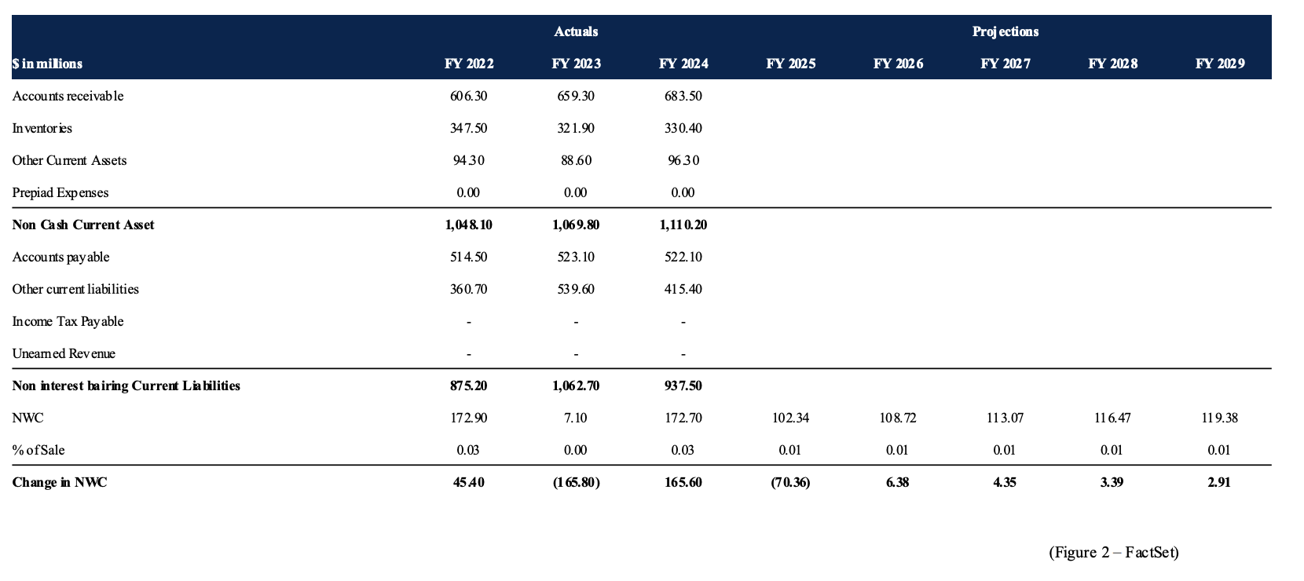
Company Analysis
Research Report | 11.30.2025
Financial Statements
Net Working Capital Projections
Explain the historical changes in Net Working Capital and highlight any unusual volatility.
Then, explain why these changes occurred, referencing disclosures from the company’s 10-K when applicable.
For the projection period, describe the assumptions used to stabilize NWC and explain how this affects future Free Cash Flow.
You can also add some data like the image below.

Slide 6
Valuation
Research Report | 11.30.2025

Slide 7
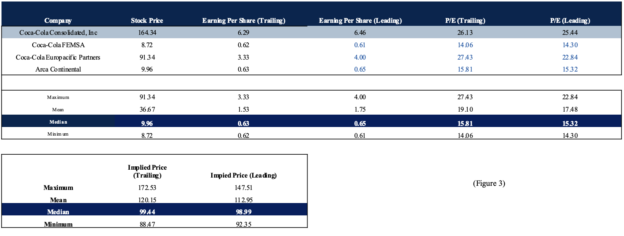
Valuation
Research Report | 11.30.2025
P/E Model
P/E Model
Explain why a comparable company analysis is appropriate for valuing the firm and justify the selection of the peer group.
Then, explain which valuation multiples are used and why certain metrics may be more appropriate given the company’s capital-intensive business model.
Next, describe how the implied share price is calculated using the selected multiple and why the median value is preferred when the comparable set is small.
Finally, compare the implied share price to the current market price and explain what this suggests about whether the stock is overvalued or undervalued.
You can also make a chart from Excel, etc.
Here’s an example:

Slide 8
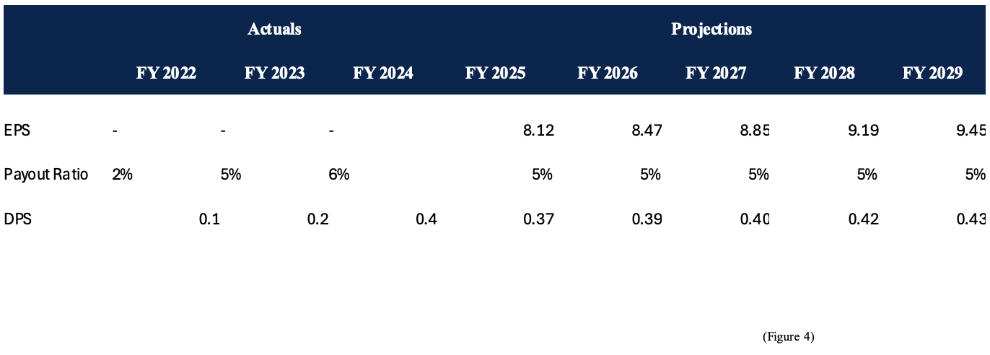
Valuation
Research Report | 11.30.2025
DDM Model
DPS Projection
Explain how projected EPS is calculated using the projected income statement and total shares outstanding.
Then, explain the dividend policy assumption applied.
Next, describe how DPS is estimated by applying the payout ratio to projected EPS.
You can also reference figures or tables from Excel or other programs to support the EPS growth and DPS calculations.

Slide 9
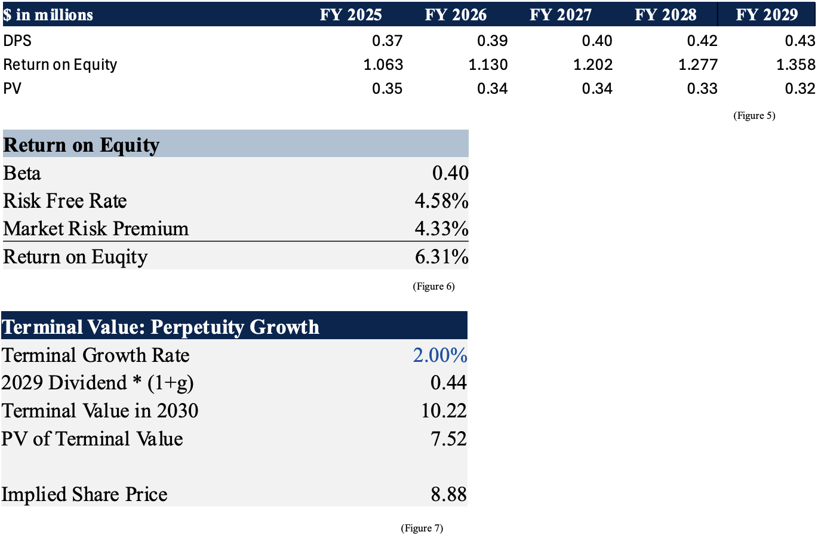
Valuation
Research Report | 11.30.2025
DDM Model
DDM Calculation
First, use the projected Dividends Per Share to calculate the present value of dividends for each year in the explicit forecast period.
Next, calculate the cost of equity using the Capital Asset Pricing Model (CAPM), clearly stating the assumptions for beta, the risk free rate, and the market risk premium.
Then, select an appropriate terminal growth rate based on the company’s maturity and long term growth outlook, and calculate the terminal value.
Finally, add the present value of the terminal value to the sum of discounted dividends to arrive at the implied share price, and briefly discuss whether the DDM is suitable given the company’s dividend policy and capital allocation strategy.

Slide 10
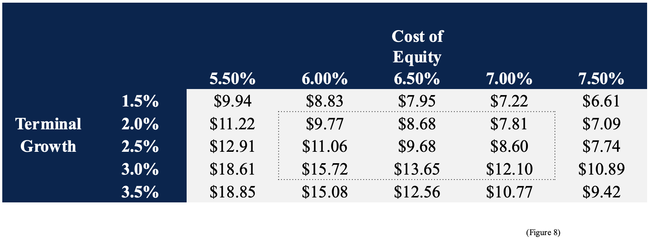
Valuation
Research Report | 11.30.2025
DDM Model
DDM Sensitivity Analysis
Dividend Discount Model’s sensitivity analysis shows how much the implied share price changes when cost of equity and terminal growth rate changes.

Slide 11
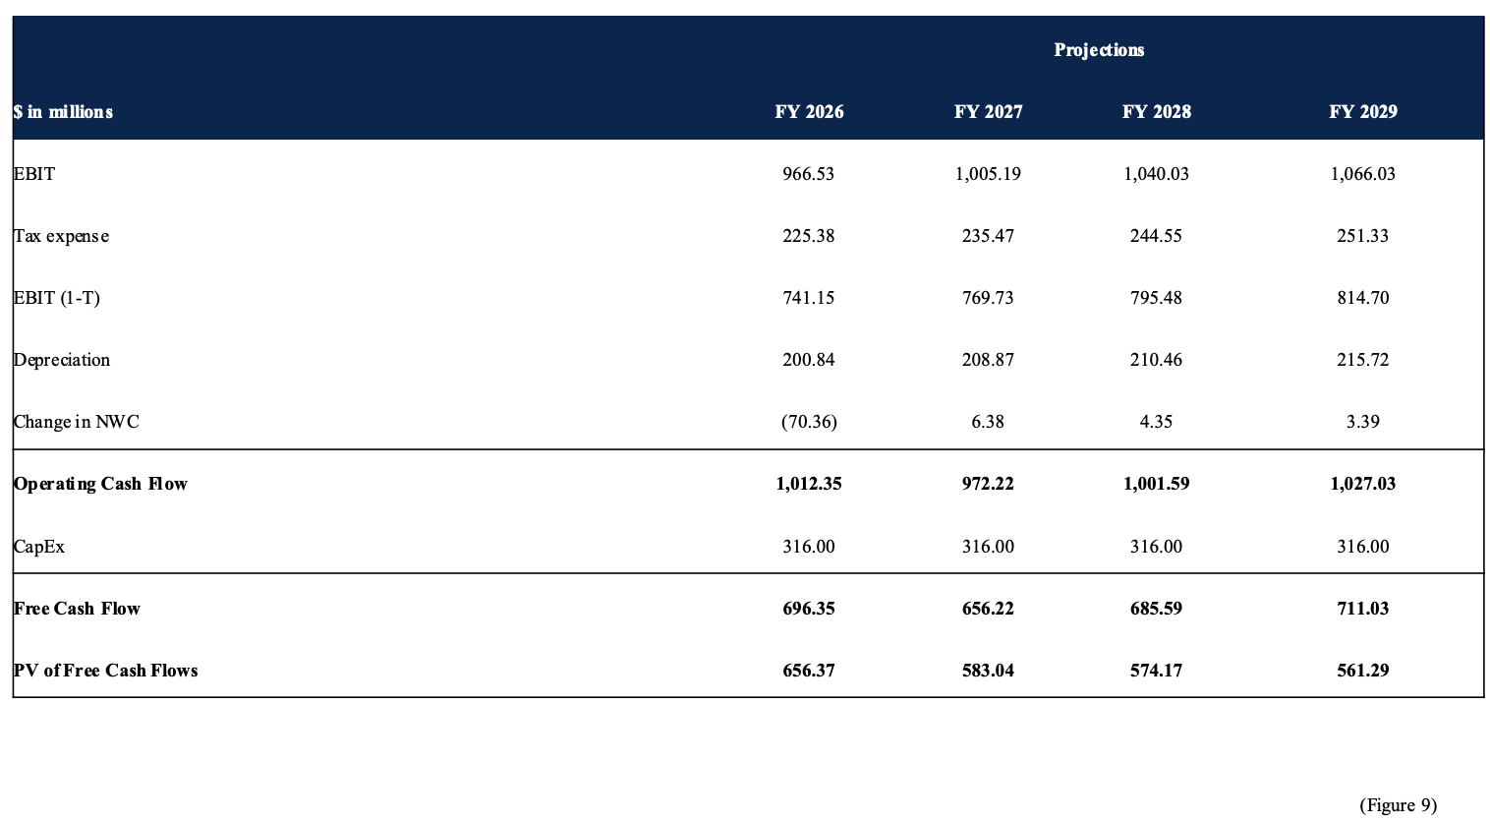
Valuation
Research Report | 11.30.2025
DCF Model
Free Cash Flow Calculations
First, use projected operating income and changes in net working capital to calculate forecasted operating cash flow over the explicit projection period.
Next, estimate capital expenditures based on historical spending patterns to reflect the firm’s ongoing reinvestment needs.
Then, calculate Free Cash Flow by subtracting projected CapEx from operating cash flow for each forecast year.
Finally, explain why Free Cash Flow is the most appropriate input for valuation and how it serves as the foundation for a Discounted Cash Flow analysis to estimate the firm’s intrinsic value.

Slide 12
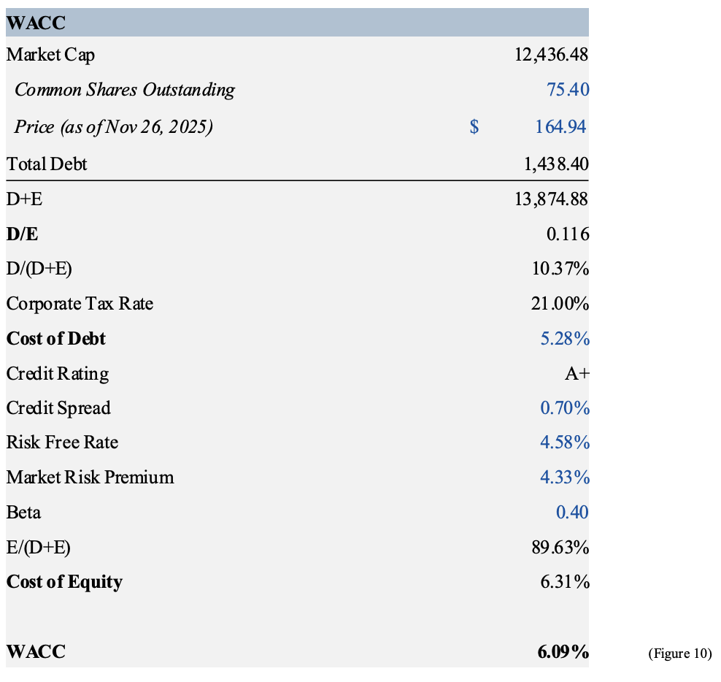
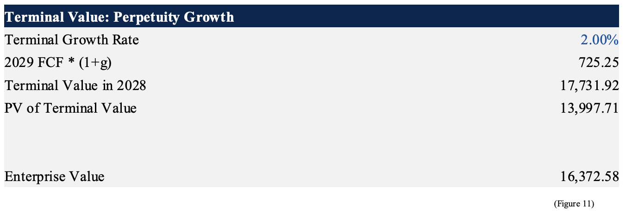
Valuation
Research Report | 11.30.2025
DCF Model
Wacc
Use the firm’s equity value and total debt to determine the capital structure weights.
Then, estimate the cost of equity using CAPM and the cost of debt based on the company’s credit quality and applicable credit spread.
Finally, combine these inputs to calculate the Weighted Average Cost of Capital, which serves as the discount rate for the valuation model.
Example: Using COKE’s equity value, total debt, CAPM (from DDM model), and cost of debt (using A+ credit spread), the WACC comes out to be 6.09% (Figure 10)
Terminal Value
Apply a terminal growth rate consistent with the assumptions used in prior valuation models to calculate the terminal value.
Then, combine the present value of projected free cash flows with the discounted terminal value to arrive at the firm’s enterprise value.
Example: Using same terminal growth rate of 2% as Dividend Discount Model, the enterprise value of COKE comes out to be $16,372.58 (Figure 11).

Slide 13
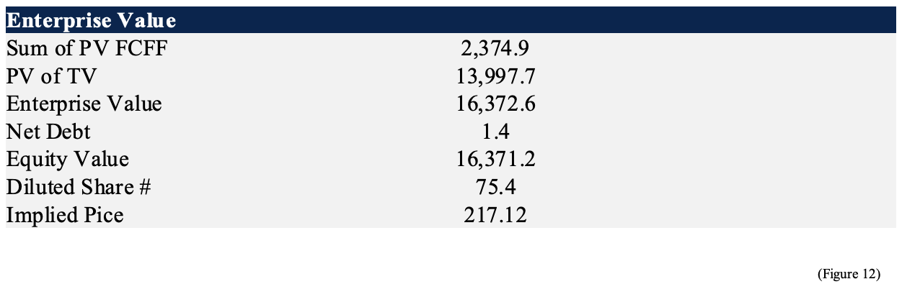
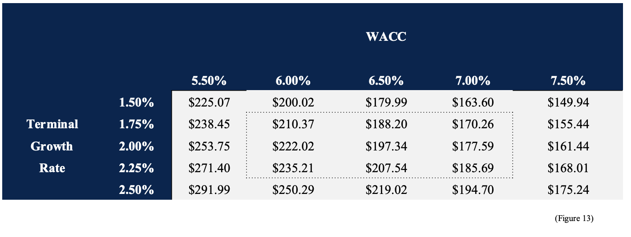
Valuation
Research Report | 11.30.2025
DCF Model
Implied Share Price
First, convert enterprise value to equity value by deducting net debt.
Next, divide the resulting equity value by the number of shares outstanding to obtain the implied share price from the DCF model.
Then, compare the implied share price to the current market price to assess potential upside or downside.
Finally, perform a sensitivity analysis across a reasonable range of WACC and terminal growth rate assumptions to evaluate how robust the implied valuation is to changes in key inputs.
DCF Sensitivity Analysis
First, set up a sensitivity table by varying the two key DCF assumptions: the terminal growth rate and the weighted average cost of capital.
Next, calculate the implied share price for each combination of WACC and terminal growth assumptions.
Then, identify a base case within the table to serve as the central valuation reference point.
Finally, use the table to observe how changes in the discount rate and long term growth assumptions affect the implied share price, noting the inverse relationship between WACC and valuation.

Slide 14
Conclusion &
Recommendations
Research Report | 11.30.2025

Slide 15
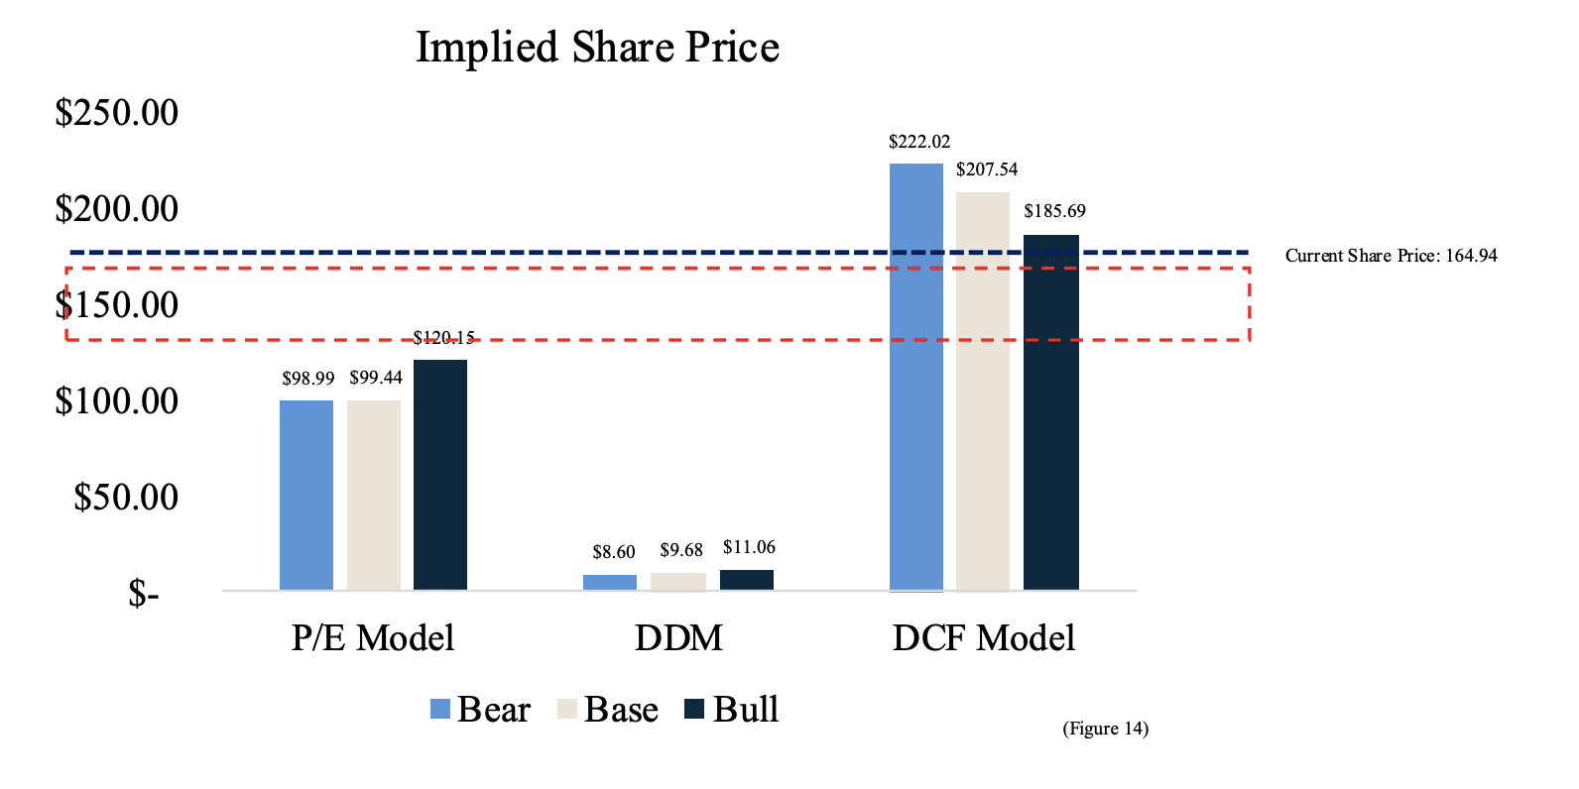
Conclusion & Recommendations
Research Report | 11.30.2025
Conclusion on three valuation models: P/E, DDM, DCF
First, calculate the implied share price under each valuation model, such as P/E, Dividend Discount Model, and Discounted Cash Flow, using the projected financial statements.
Next, compare the results across models and interpret why the implied values may differ, recognizing that each model emphasizes different aspects of the firm’s financial profile.
Then, evaluate which models are more appropriate based on the company’s dividend policy, growth prospects, and cash flow generation.
Finally, use the most relevant models to establish a reasonable implied valuation range and compare it to the current market price to assess whether the firm appears fairly valued, undervalued, or overvalued.

